Slide 1
TO GET INVOLVED IN YOUR COMMUNITY

Slide 2
WOULD YOU RATHER
Meet an alien
Meet a mermaid

Slide 3
OBJECTIVES
Review the importance of getting involved in your community
Learn about ways to make a choice to get involved in your community
Reflect on why it is important to stay involved in your community

Slide 4
WHY GET INVOLVED IN YOUR COMMUNITY?
When you make a choice to get involved in your community, you can learn new skills, open new opportunities, and help build a stronger community.
Being involved helps you feel more connected to your community and can build a sense of solidarity.
Building solidarity helps create a healthy world where you can help those in need.

Slide 5
GETTING INVOLVED IN YOUR COMMUNITY
Some choices you can make to get involved in your community include:
Volunteering your time
Offering resources to those who need it
Joining a club in your school to promote community

Slide 6
What are other choices you can make to get involved in your community?
DISCUSSION

Slide 7
WHAT IS COMMUNITY?
Notes:
https://youtu.be/rqMtpk754ns

Slide 8
VOLUNTEERING
Sharing your time makes your community stronger. Volunteering can:
Help you to discover what you are passionate about and build a network for your future.
Help you learn new skills and grow as a person.
Give you more understanding of the things that you like.

Slide 9
DONATING FOOD, MONEY OR CLOTHES
Choosing to donate resources can help build a healthy environment for others.
Contributing to your local community can really help those in need.
If you can, with the approval of your family, donate clothes or household goods to your local organization.
Donating food or money can become a little tricky but if you have the capacity to make that choice, great!
Fundraisers, like car washes, are simple and fun ways to earn money for a charity of your choice. You can get creative!

Slide 10
JOIN A CLUB AT YOUR SCHOOL
When you make a choice to join a club at your school you can connect with your peers to work on creating change in your community.
Many schools have a Student Together Organizing Peace (STOP) club, a Genders & Sexualities Alliance (GSA) club, or a Social Justice Club.
This is an opportunity for you to find like-minded individuals to create change on issues you’re passionate about.

Slide 11
DISCUSSION
Have you ever made the choice to join a club at school?
What was your experience like?

Slide 12
MAKE A CHOICE!
Start a club at your school! Here are some tips to get started:
Talk to your school administrator: Your school administrator will help guide you through the process of starting a club.
Find a sponsor: This can be a teacher who is willing to provide space and time for when you meet with your group.
Create a team: Reach out to students who are interested in the same thing you’re passionate about.
Schedule meetings: Organize meeting dates and times to brainstorm ideas and talk about activities to spread awareness on your chosen topic.
Connect with other organizations for support: Find organizations in your local community to support your school club.

Slide 13
WHY JOIN/START A CLUB?
Notes:
https://youtu.be/hEj9mngRlc4

Slide 14
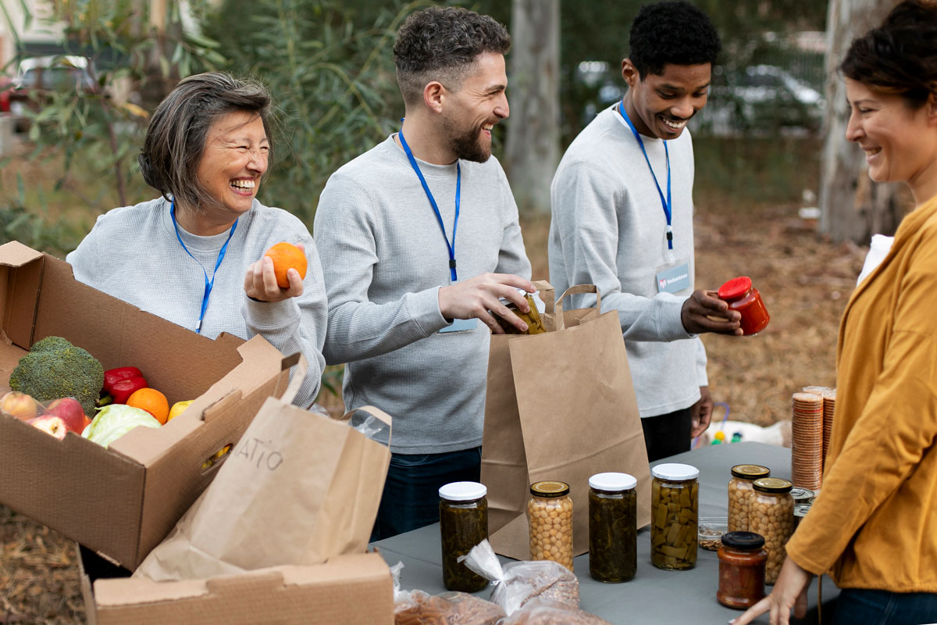
DISCUSSION
What are other choices you can make to give back to your community?

Slide 15
CHECK OUT
What will you do for yourself today?
Drink More
Water
Take A
Relaxing
Bath
Set Goals
For The Next
Week
Try a New Hobby
Move your Body
Find A New
Podcast To
Listen To
Attempt Some Artwork
Read A
Book
Get Some Sleep

Slide 16
Committed to fostering a safe and respectful District, school and community culture where the seeds of peace and justice are sown so that all students and staff can lead safe, purposeful and academically fruitful lives.
Connect with us at bit.ly/LAUSD-HRDE

